Slide 1
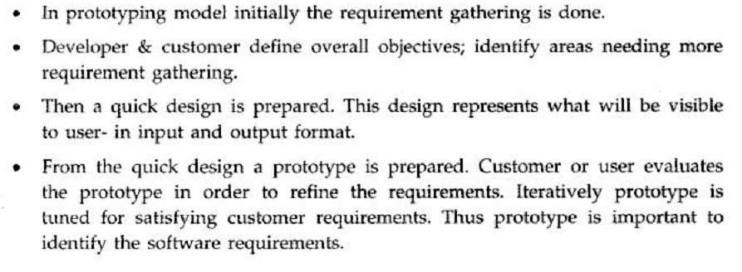
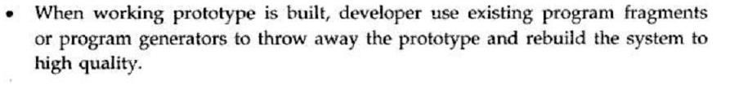
2. Prototype Model

Slide 2
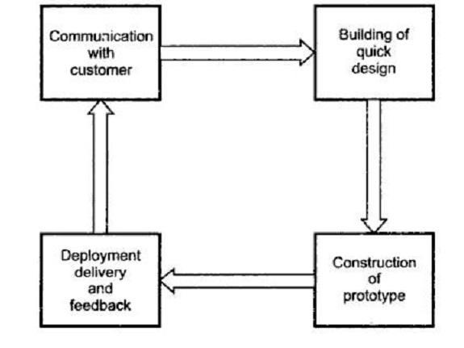
Prototype Model

Slide 3
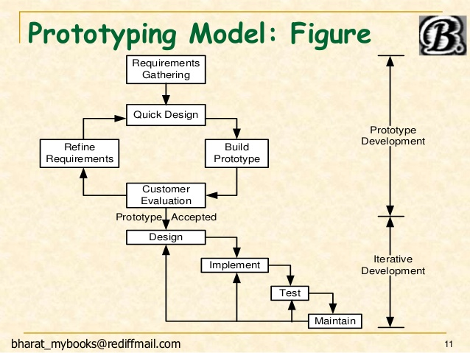

Slide 4
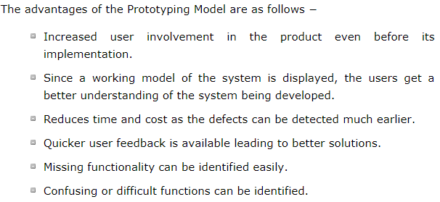
Advantages

Slide 5
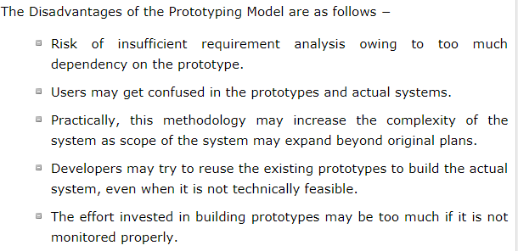
Disadvantages

Slide 6
When to Use…..
Requirements are unstable
Short lived demonstration required
when the desired system needs to have a lot of interaction with the end users.
Typically, online systems, web interfaces have a very high amount of interaction with end users, are best suited for Prototype model. It might take a while for a system to be built that allows ease of use and needs minimal training for the end user.
Prototyping ensures that the end users constantly work with the system and provide a feedback which is incorporated in the prototype to result in a useable system. They are excellent for designing good human computer interface systems.

Slide 7
3. Iterative Enhancement Model
This model has the same phases as the waterfall
model, but with fewer restrictions.
Generally the phases occur in the same order as in the waterfall model, but they may be conducted in several cycles.
Useable product is released at the end of the each cycle, with each release providing additional functionality.

Slide 8
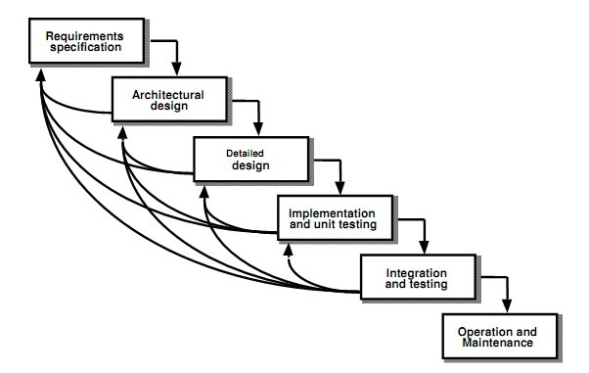
Iterative Enhancement Model

Slide 9
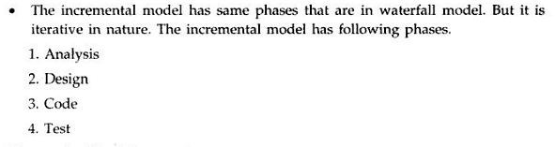
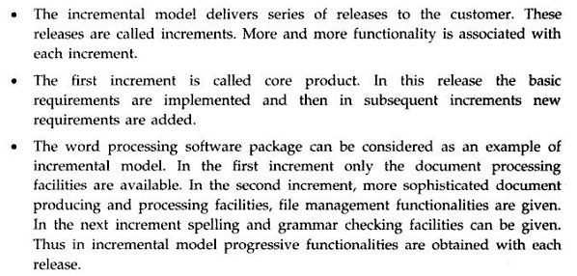
Iterative Enhancement Model(Incremental Model)

Slide 10
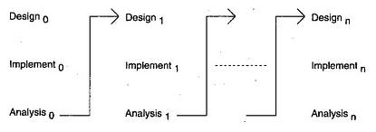

Slide 11
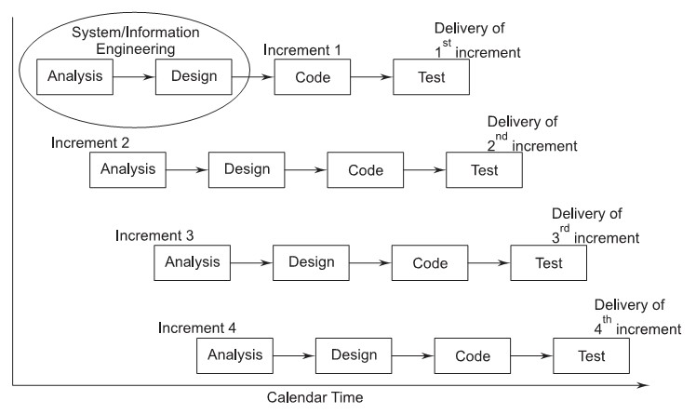
Iterative Enhancement Model(Incremental Model)

Slide 12
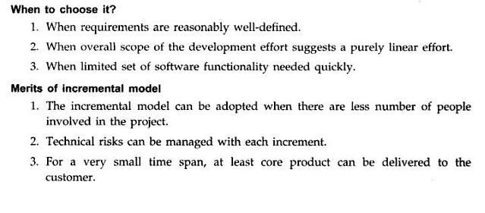
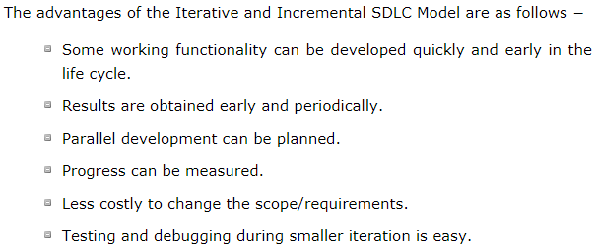
Iterative Enhancement Model(Incremental Model)

Slide 13
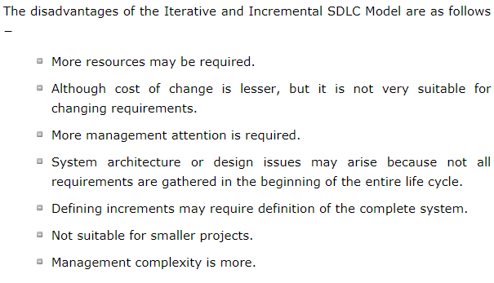
Demerits of Iterative model:
Each phase of an iteration is rigid with no overlaps
Costly system architecture or design issues may arise because not all requirements are gathered up front for the entire lifecycle

